Slide 1
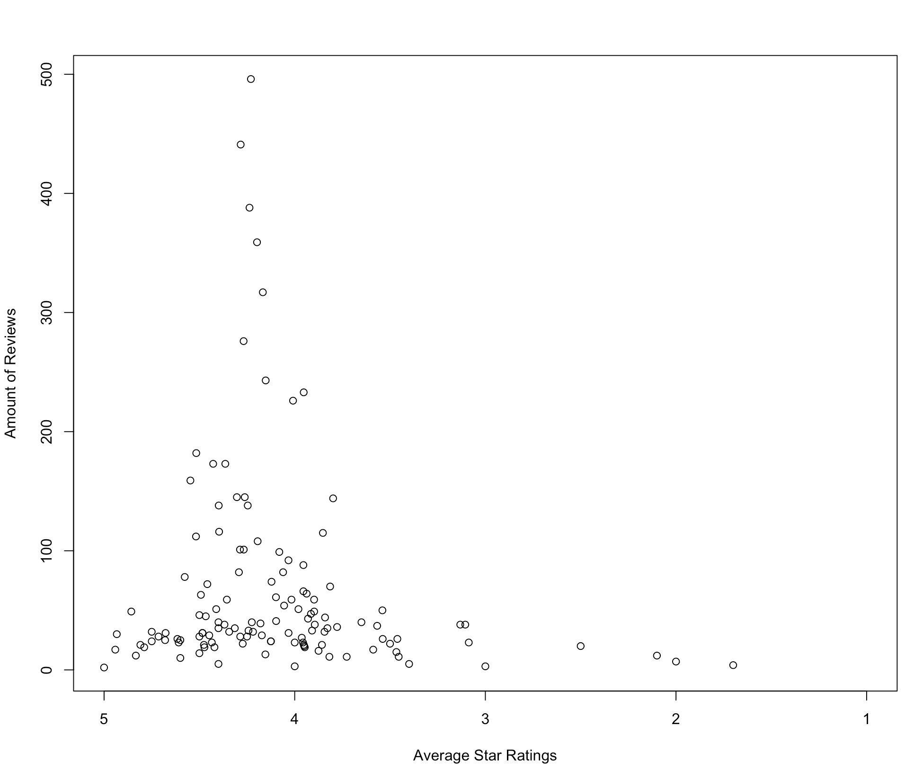
Polynomial Regression

Slide 2
Hair Dryer
Pacifier
Amount of Reviews
Amount of Reviews
Average Star Ratings
Average Star Ratings

Slide 3
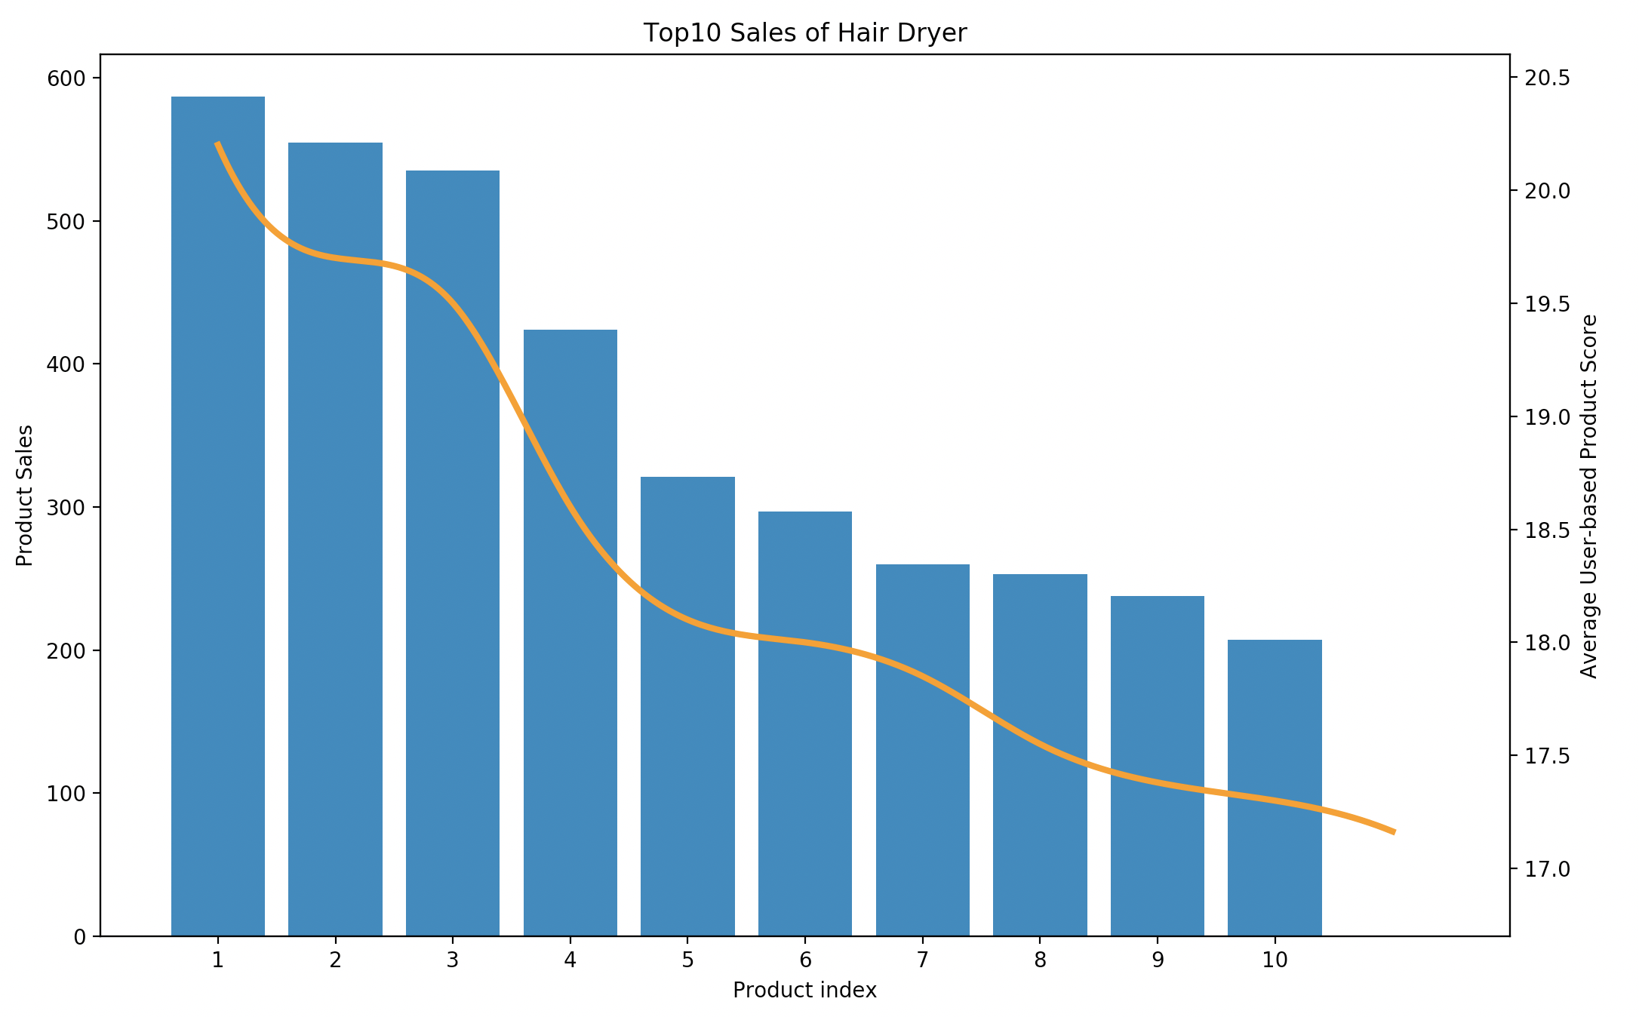
Product Sales
User-based Product Score

Slide 4
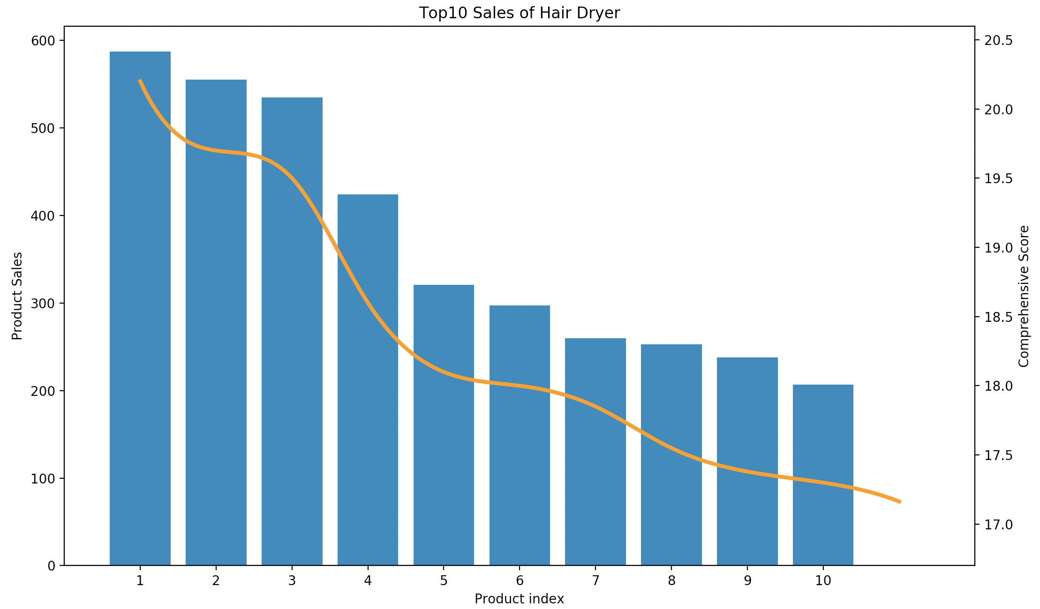
Product Sales
Comprehensive Score

